Slide 1
KNN (K Nearest Neighbors)
Sang Yup Lee

Slide 2
Machine Learning
Types of problems that can be addressed by ML approaches
Supervised learning algorithms
Regression problems
When the dependent variable is a continuous variable
Algorithms: Linear regression models
Classification problems
When the dependent variable is a categorical variable
Algorithms: KNN, Logistic regression, SVM (support vector machine)
Unsupervised learning algorithms
Clustering, Dimension reduction

Slide 3
Classification problems
Examples
Binary classification (when the DV takes two different values)
Whether a person as a lung cancer
Whether a movie is a hit or flop
Whether a consumer buys product A
Multiclass classification (when the DV takes more than two values)
The section of a news article
Movie genres
Course grades (A, B, C, D, F)

Slide 4
KNN
KNN (K Nearest Neighbors)
Supervised learning
For classification problems
데이터 포인트를 독립변수 정보를 이용해서 하나의 vector로 표현
학습 데이터 이용 (아래, 빨간색 class와 초록색 class)
For a given data point, to predict its class (DV), KNN looks for K nearest neighbors’ classes
The class of the data point is determined according to the class that most of the K nearest neighbors have
To find K nearest neighbors, the distance between the given data point represented by a vector and other data points in the training data is calculated.

Slide 5
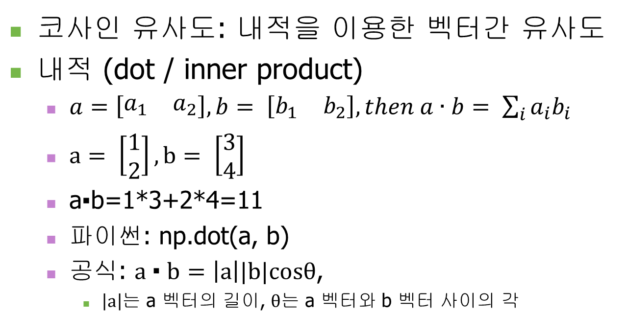
KNN
KNN (K Nearest Neighbors)
Class assignment: the class of most neighbors among K neighbors
Mathematical form
Calculate conditional probability
P(Y = j | X = x₀) = $\frac{1}{K}\sum_{i ∈ N}{I(}y_{i}=j)$

Slide 6
KNN
X

Slide 7
KNN
Implementing KNN
Steps
Prepare data with answers
Split into training and test data
Learning through the training data
Evaluate the model performance using test data
Predict a new flower

Slide 8
Exercise
신문기사의 섹션 정보 예측하기
정치 기사 인가 경제 기사 인가?
순서
정답이 있는 데이터 준비하기
데이터를 DTM으로 표현하기
Training data와 test data로 구분하기
Training data를 사용해서 학습하기
Test data를 사용해서 평가하기
새로운 데이터의 값 예측하기

Slide 9
Q & A

